Slide 1
DD Waiver Online Claims Entry
CMS-1500
Conduent
Government Healthcare Solutions

Slide 2
Purpose
The purpose of this workshop is to provide an overview of the CMS-1500 direct data entry instructions for DD Waiver Providers. Having an understanding of CMS-1500 direct data entry instructions will improve billing practices by reducing claim denials and ensuring all rendered services are billed properly.

Slide 3
Objectives
  DD Waiver Provider Information on Submitting Online CMS-1500 Claims:
    Claim Form Instructions
    Timely Filing
    Add/Manage Templates
    Medicaid Primary Claims – Online Claim Entry

Slide 4
Getting Access to Bill on the Web Portal
If you are currently not registered on to the New Mexico Medicaid Web Portal you can create an account using either your active New Mexico Medicaid Provider ID or your NPI using the following link: https://nmmedicaid.portal.conduent.com/webportal/webRegistration/webRegStart
If your New Mexico Provider ID or NPI is currently registered on the New Mexico Medicaid web portal but you do not have access to log in, or do not have Claims Entry access, please contact your Master Administrator.
If you do not know if your Provider ID or NPI is registered on the New Mexico Medicaid Web Portal or if you do not know who your Master Administrator is, you can contact the HIPAA Helpdesk for further assistance at 1-800-299-7304 or by email at HIPAA.DeskNM@hsd.nm.gov.

Slide 5
Claim Form Instructions
Conduent
Government Healthcare Solutions

Slide 6
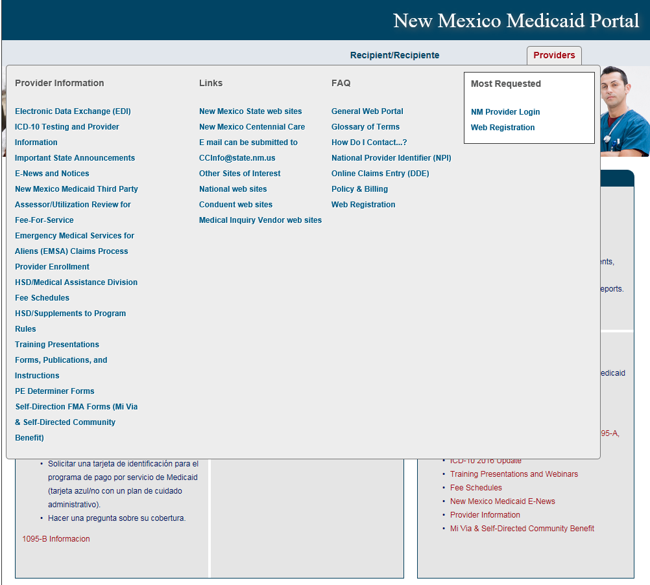
Where Do I Get a Copy of Claim Form Instructions?
On the WEB PORTAL: Click Providers then Forms, Publications, and Instructions under Provider Information

Slide 7
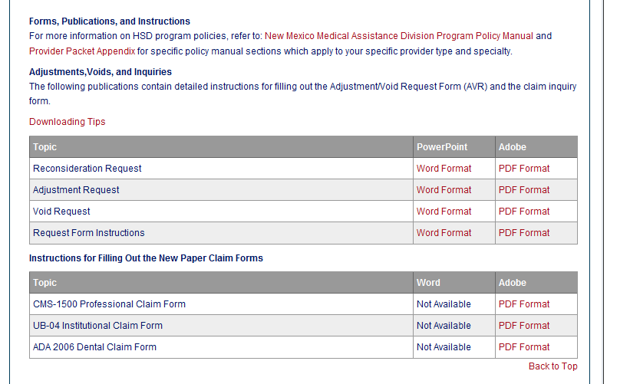
Where Do I Get a Copy of Claim Form Instructions?

Slide 8
What is a Transaction Control Number (TCN)?
92204900001000033
The twelfth digit in an adjustment/ void TCN will either be:
1= Debit
2= Credit
The first digit indicates what the claim “media” is:
2 = electronic crossover
3 = other electronic claim
4 = system generated claim or adjustment
8 = paper claim
9 = Web portal claim entry
Batch number
The last two digits of the year the claim was received
The numeric day of the year.
The claim number within the batch.
This is the Julian Date - this represents the date the claim was received by Conduent: this claim was received the 49th day of 2022, or February 18, 2022.
Notes:
Global slide – indicate somehow

Slide 9
Timely Filing
Conduent
Government Healthcare Solutions

Slide 10
Timely Filing Limit
The initial timely filing limit for claims is 90 days from the last date of service on the claim or the payment date of a Medicare or commercial insurance EOB.
If a claim is denied, a 90 day grace period begins on the remittance date of the denial. The claim must be resubmitted within this 90 day period, and can be resubmitted as many times as needed.
The TCN of the original denied claim is required for proof of timely filing on resubmitted claims. Claims submitted electronically, on paper, or on the web portal can be used for proof of timely filing on web portal resubmissions.

Slide 11
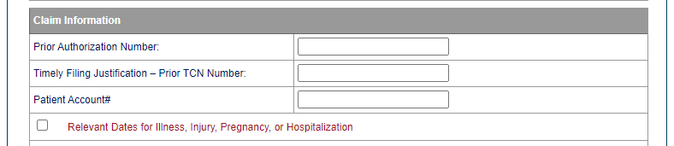
Timely Filing Limit
When resubmitting claims on the web portal, indicate the denied claim TCN in the “Timely Filing Justification – Prior TCN Number” field.
Notes:
Important Note: Remittance Advices are not considered proof of timely filing.

Slide 12
Creating and Managing Templates
Conduent
Government Healthcare Solutions

Slide 13
Claim Templates
Claim Templates are used to expedite entry of multiple claims that have the same information (same client, identical charge lines, etc.)
Claim templates are unique to each biller account.
Each biller account can have up to 25 templates at one time.

Slide 14
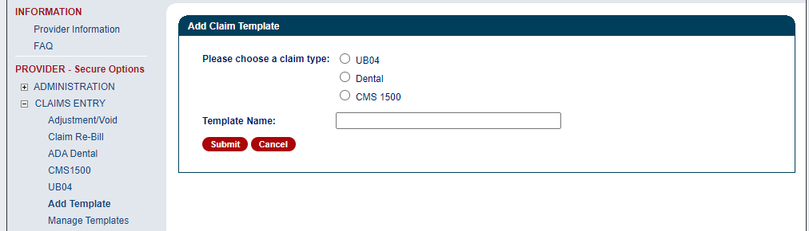
Claim Templates
To create a template, click Add Template. Choose the claim type and enter a name for the new template.

Slide 15
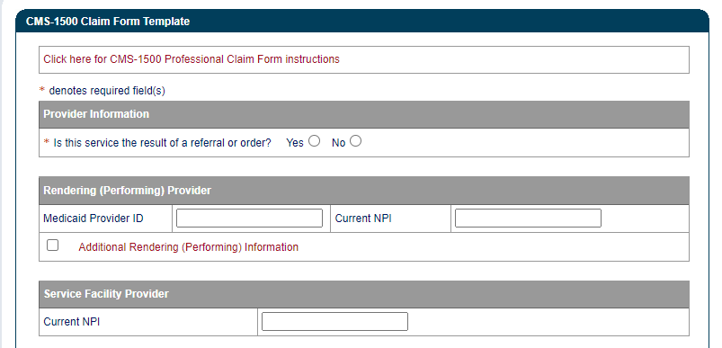
Claim Templates
Enter the claim information to be saved on the template. When using the template to submit new claims, all of this information will already be entered. Click Save.

Slide 16
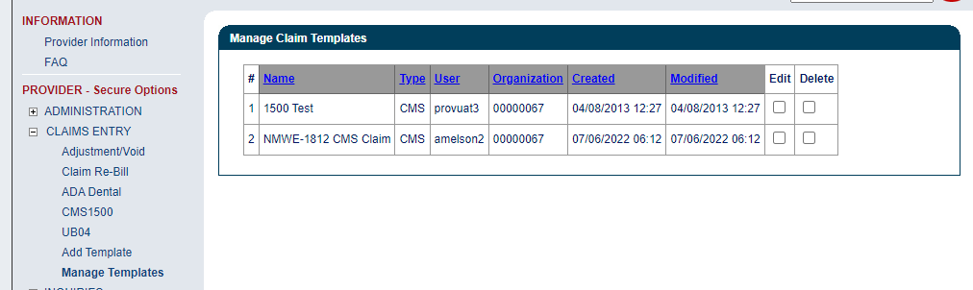
Claim Templates
Templates can be edited or deleted using the Manage Templates function.

Slide 17
Medicaid Primary Online Claim Submission
Conduent
Government Healthcare Solutions

Slide 18
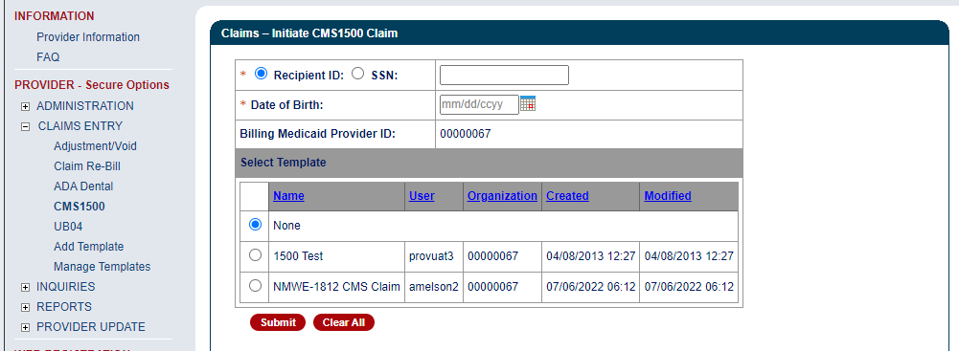
Online Claim Entry
To initiate claim entry, click on CMS1500. Enter the Recipient ID and Client date of birth. Select a template if one is being used.

Slide 19
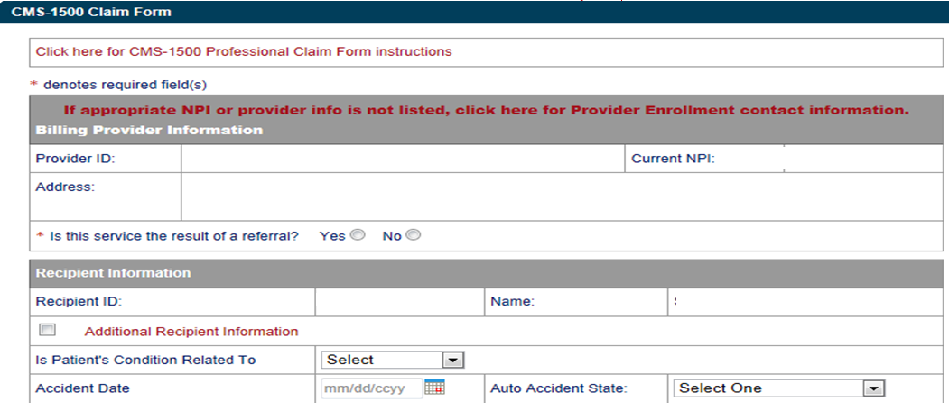
Online Claim Entry
Click on the RED text for the CMS 1500 Claim form instructions

Slide 20
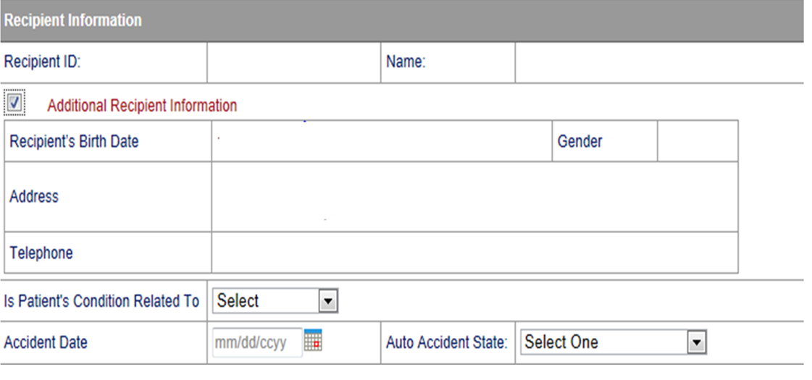
Online Claim Entry
Click “Additional Recipient information” if patient condition information is needed on the claim.

Slide 21
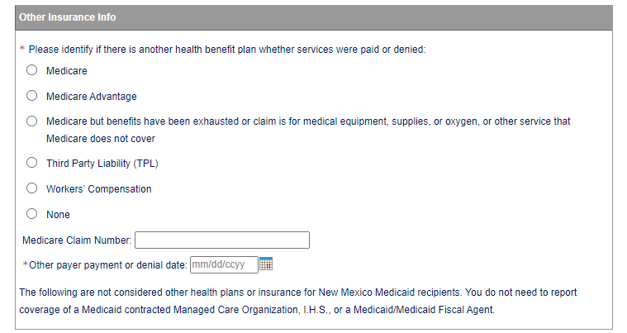
Online Claim Entry
If there is another payer, whether services paid or denied, click on the corresponding plan. If there is not another payer, click None. Instructions for Medicare, Medicare Advantage, and Third Party Liability claims are in following sections.

Slide 22
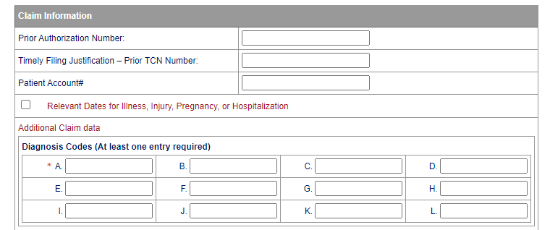
Online Claim Entry
Enter Prior Authorization number if required, TCN for proof of timely filing for resubmission, relevant dates if required, and diagnosis codes.

Slide 23
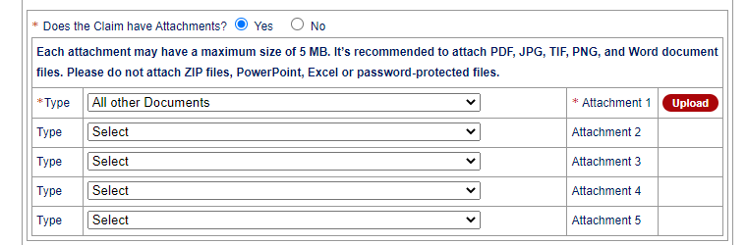
Online Claim Entry
If attaching documents to the claim, click Yes on the attachment question. Open each pull-down menu and select the type of document being attached. Click upload to select each file.

Slide 24
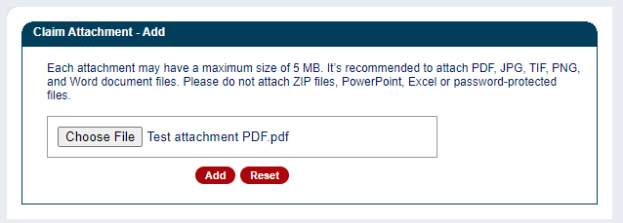
Online Claim Entry
Click Browse to select the document to be uploaded and click Add. Up to five attachments can be uploaded.

Slide 25
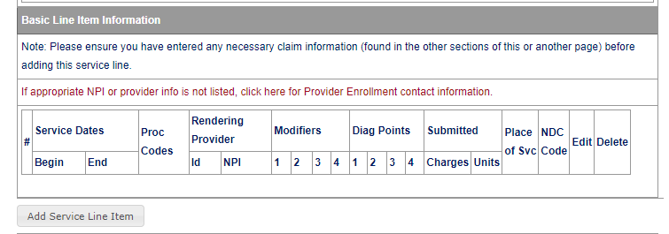
Online Claim Entry
To begin entering the service line items, click Add Service Line Item.

Slide 26
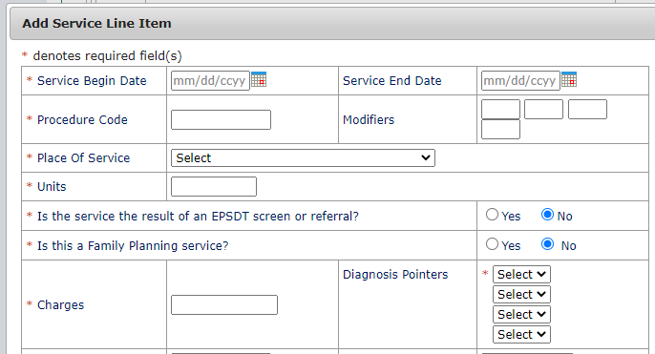
Online Claim Entry
Enter the service line information. Items with asterisk (*) are required. Enter each additional service line.

Slide 27
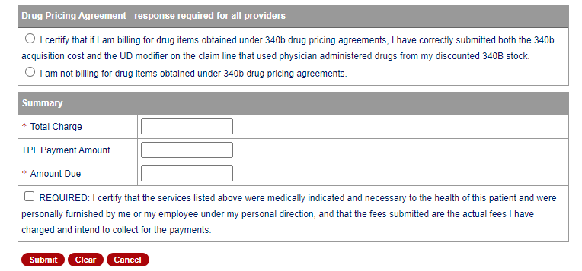
Online Claim Entry
Select the appropriate drug pricing statement. Enter the claim total charge in the Total Charge and Amount Due fields. Click on the Required statement and Submit.
Notes:
NO enforcement on the data entered into the Summary fields.

Slide 28
Claims Re-Bill
Conduent
Government Healthcare Solutions

Slide 29
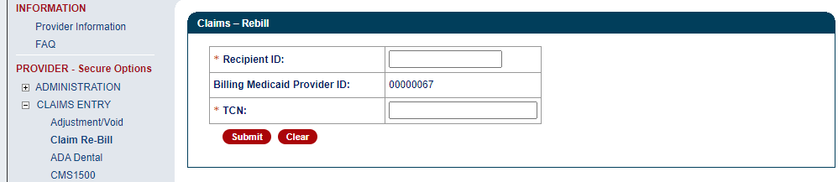

Claims Re-Bill
Claims Re-Bill allows claims that were denied to be resubmitted without entering the full claim again.
Only claims that were originally submitted on the web portal can be Re-Billed on the portal.
To re-bill a denied claim, click Claim Re-bill under Claims Entry.
Enter the Recipient ID and TCN of the denied claim and submit.
When re-billing, you will need to use the TCN of the original claim as proof of timely filing.
Notes:
If you have claims that were submitted within the 90 day limit from the primary insurance’s payment date but denied for timely filing due to the 210 day final filing limit policy AND you have proof the claims were submitted to the primary insurance within 90 days of the date of service AND either a delay in processing the claim or appeals and reconsideration requests caused the claim to exceed the 210 day final filing limit the claims can be resubmitted with a reconsideration request.

Slide 30
CMS 1500 Tips
  Enter an original claim TCN for proof of timely filing if rebilling a denied claim.
  Attach EOBs if primary payer is Medicare, Medicare Advantage, or the client has commercial insurance.
  EOB payment dates are required for Medicare and Medicare Advantage claims.
  Upload all required documents.

Slide 31
New Mexico Medicaid Resources
New Mexico Medicaid Online
      Provider Information
      Provider Login Screen Notices
      Provider E-News Newsletters
Medicaid Provider Relations Call Center
Provider Communication Updates
Provider Field Representative
Provider Webinars
Open Forums and Live Training Sessions
Continued on next page . . .

Slide 32
New Mexico Medicaid Resources Continued
New Mexico Medicaid Portal – https://nmmedicaid.portal.conduent.com/static/index.htm
Claim Inquiries, Eligibility Verification, Electronic Claim Submission, Provider Manuals, E-News
NM Health Care Authority – http://www.hca.nm.gov
Supplements, Memos, Provider Billing Packets and Policy
Medical Assistance Division – PE Program Staff – HSD.PEDeterminers@state.nm.us
Assistance with PE Applications, PE Determinations, MAD 070, PE Training, PE Certification
Consolidated Customer Service Call Center – (800) 299 - 7304
Claim Status, Eligibility, Prior Authorization, Medicaid Updates
Conduent Provider Relations Helpdesk – NMProviderSUPPORT@conduent.com
Claim research assistance and general Medicaid inquiries
Conduent HIPAA Helpdesk – HIPAA.DeskNM@hsd.nm.gov
Assistance on NM Web Portal, EDI inquiries, and Online Claim Submission with DDE (Direct Data Entry)
Conduent Provider Enrollment Helpdesk - NMProviderSUPPORT@conduent.com
Provider Enrollment Applications, Forms & Instructions
Medical Assistance Division, Program Rules – http://www.hca.nm.gov/providers/rules-nm-administrative-code/
NMAC for Programs administered by the Medical Assistance Division
Yes New Mexico - https://www.yes.state.nm.us/yesnm/home/index
Apply, check, update, or renew Medical Assistance (Medicaid) benefits

